Slide 1
IIIT ADMISSIONS PREDICTON
TS- WEB/CC/AI TRACK CAPSTONE PROJECT
Presented By:
1.MISS SIMHADRI ARCHANA-RGUKT RK VALLEY
2. MISS PUNJA DHARANI-RGUKT RK VALLEY
3.MISS GOLLA LOKESWARI-RGUKT RK VALLEY
4.MISS PRASANA-RGUKT RK VALLEY
Guided By:P.RAGHAVAN

Slide 2
OUTLINE
Abstract
Problem Statement (Should not include solution)
Aims , Objective & Proposed System/Solution
System Design
System Development Approach(Technology Used)
Algorithm & Deployment
Conclusion
References
Future Scope

Slide 3
Abstract
IIIT admission Prediction is very important and plays a key role in Andhra Pradesh students who just passed 10th class. Predicting IIIT admission can be especially difficult because the students are not aware of admission requirements. For that reason, the main purpose of this research work is to provide a recommender system for early predicting IIIT admission
Therefore, To predict chance of admission first we applied Supervised Machine Learning algorithms namely Linear Regression.
The experimental results showed that the Linear Regression is the most suitable Machine Learning algorithm for predicting IIIT admission

Slide 4
Problem Statement
The students who completed tenth class have more curiosity and confusion whether they get admission in IIIT or not. At present there is no system available to help these students

Slide 5
Proposed Solution
The students who completed tenth class have more curiosity and confusion whether they get admission in IIIT or not. At present there is no system available to help these students.
For that we have proposed ‘IIIT Admission Prediction System’ which predicts the percentage of chance of getting admission into IIIT.

Slide 6
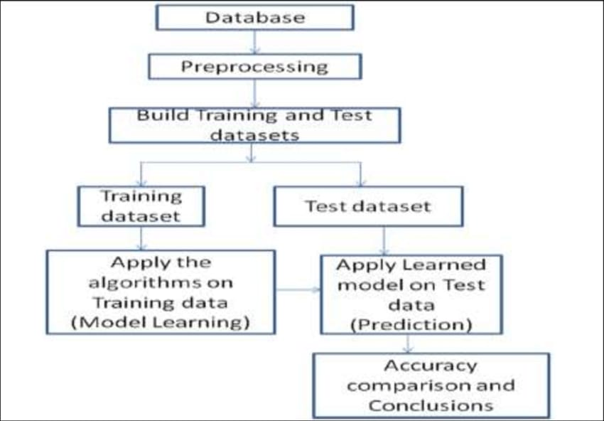
System Architecture

Slide 7
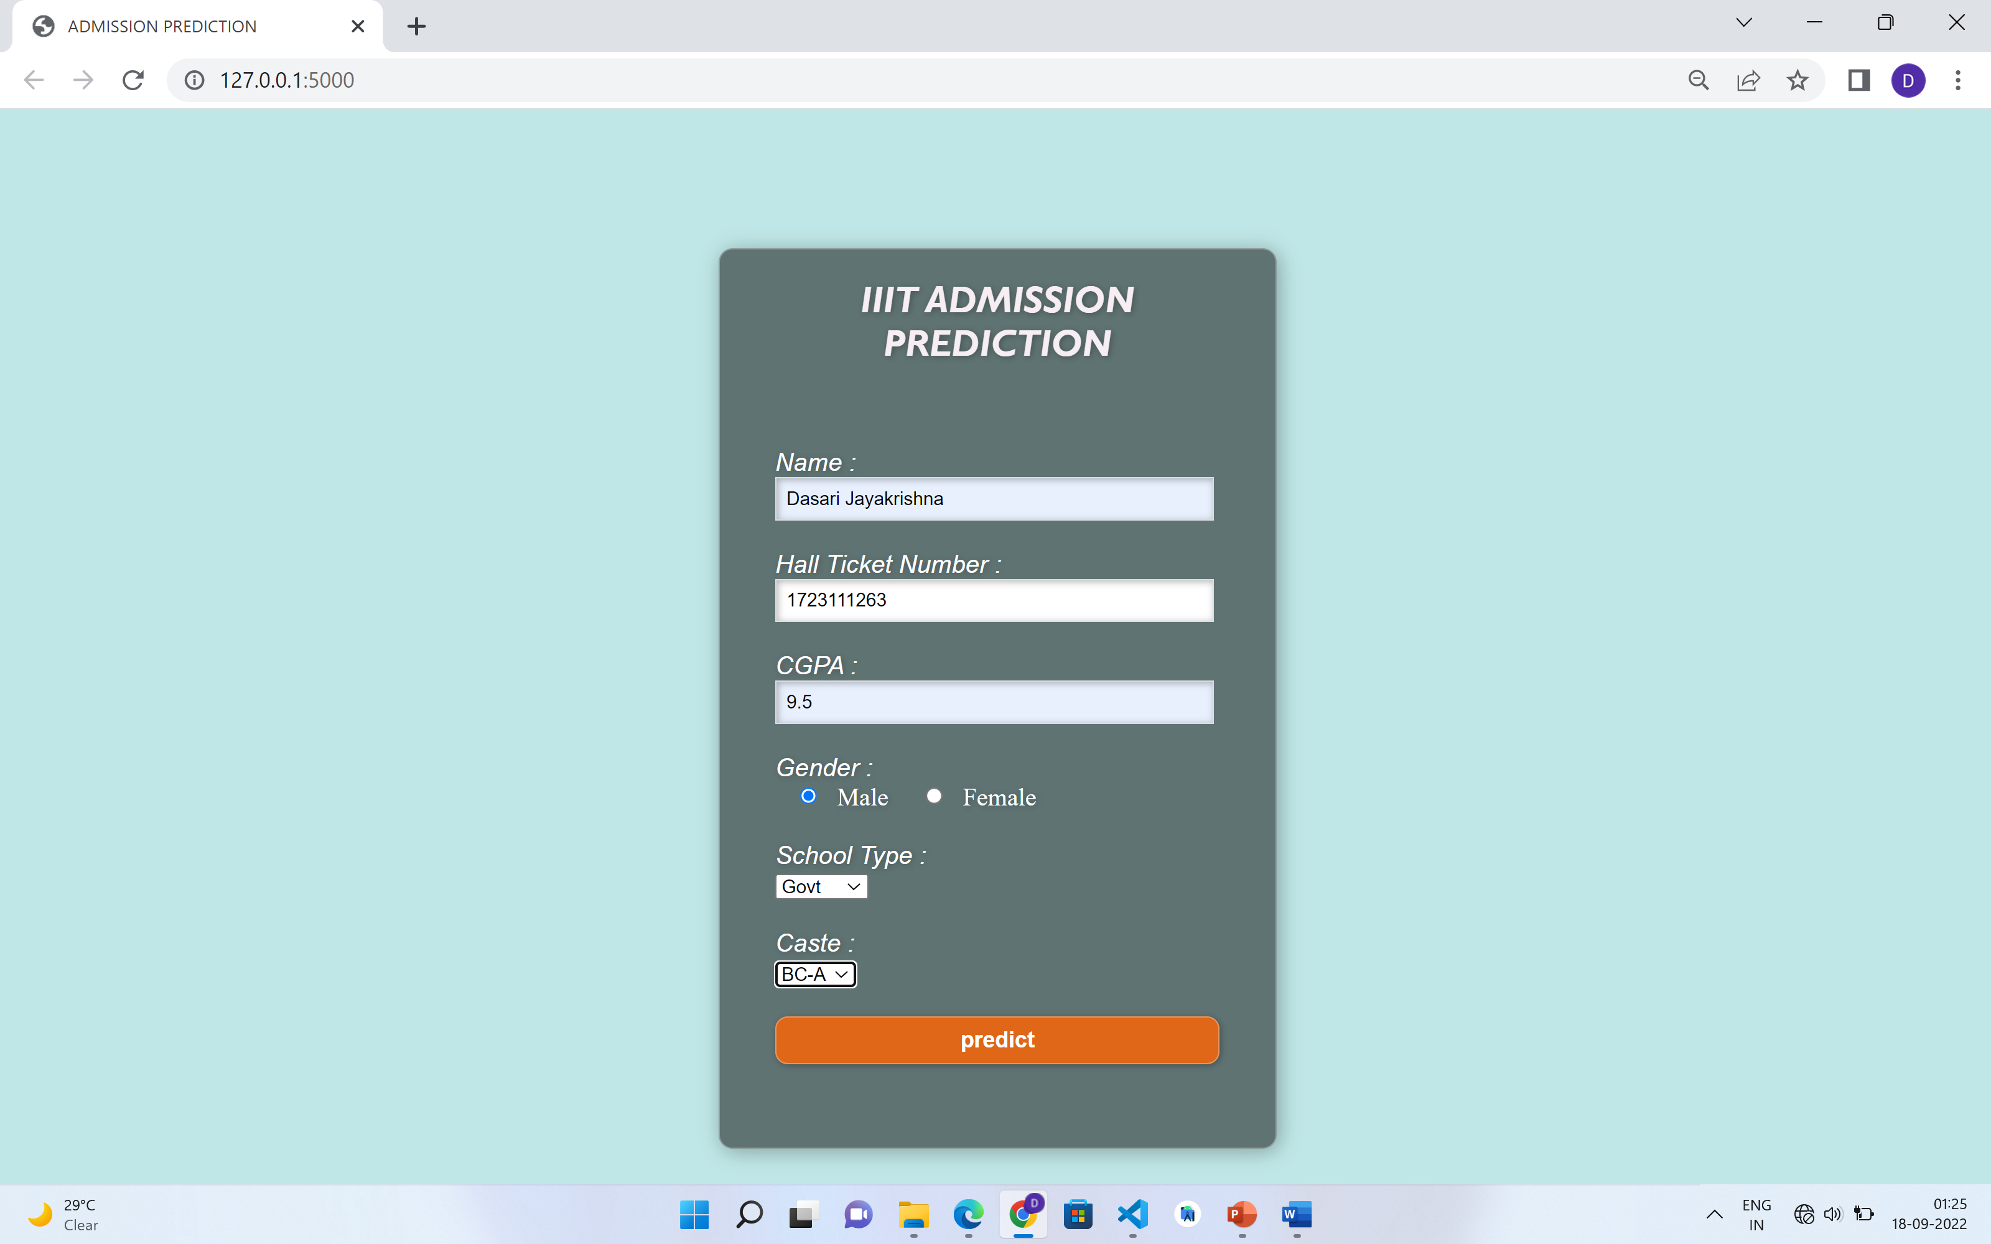
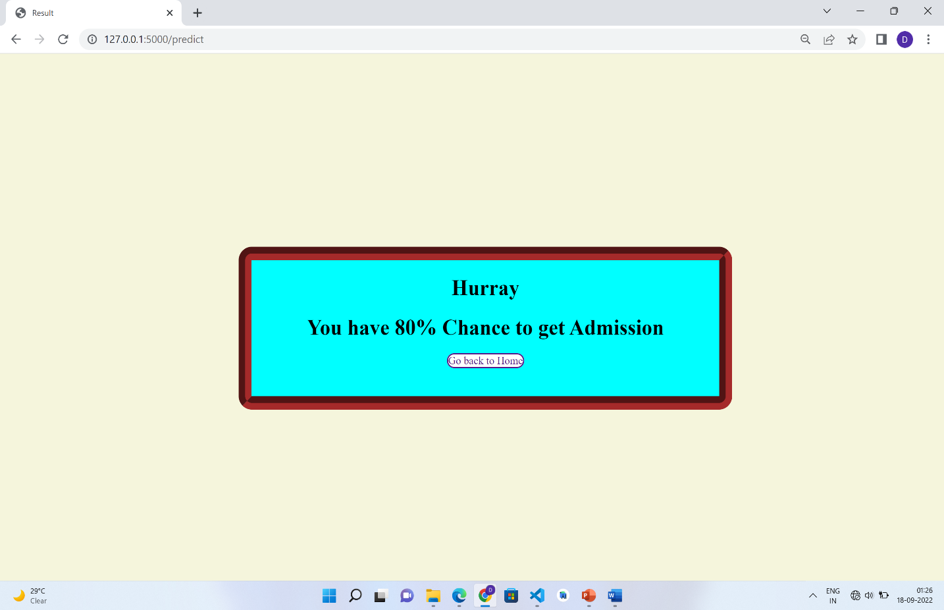
System Deployment Approach

Slide 8
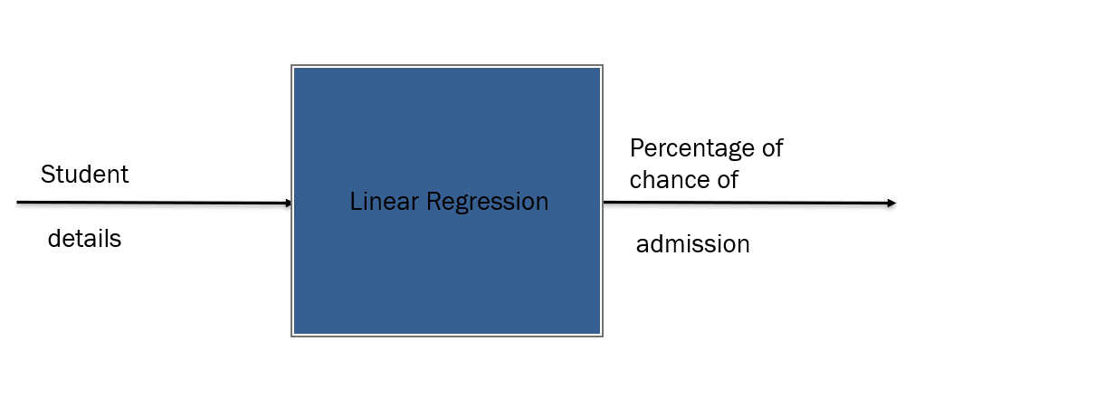
Algorithm & Deployment

Slide 9
THANK YOU

